Slide 1
Reinventing Lions Clubs

Slide 2
What is a weak club?

Slide 3
Less than 20 Members (depending on size of community)
No Community Based Service Projects
Poor Meeting
Only Fund Raise and write checks
The Same Leadership

Slide 4
How did the club get this way?
Failure to have a “club program” that appeals to current and potential members

Slide 5
Elements of Club Program
Club General Meetings
Club Business Meetings (governing)
Community Service Projects
Fund Raising
Leadership Development
Recognition

Slide 6
What can a struggling club do about community service projects
Still Do them!!!!
Find Projects that small groups can do
Partner with other groups (especially other Lions Clubs)
Invite friends and relatives to plug in on a project

Slide 7
Small Club Projects
Peace Poster
Eye or Hearing Screening
Meals on Wheels

Slide 8
Fund Raising
Ratio of Fund Raising to Members:
Annually: Do no more than one project for every 10 members
Limit fundraising: spend more time on community service

Slide 9
Leadership Development
Attend Lions Training Events!!!!
Rotate Leadership
Invite successful club leaders from other clubs to work with you

Slide 10
Recognition
Must instill feeling that club is having impact
Simple thanks means more
Invite outsiders to thank club
Special success parties

Slide 11
District Support
Club Focused District

Slide 12
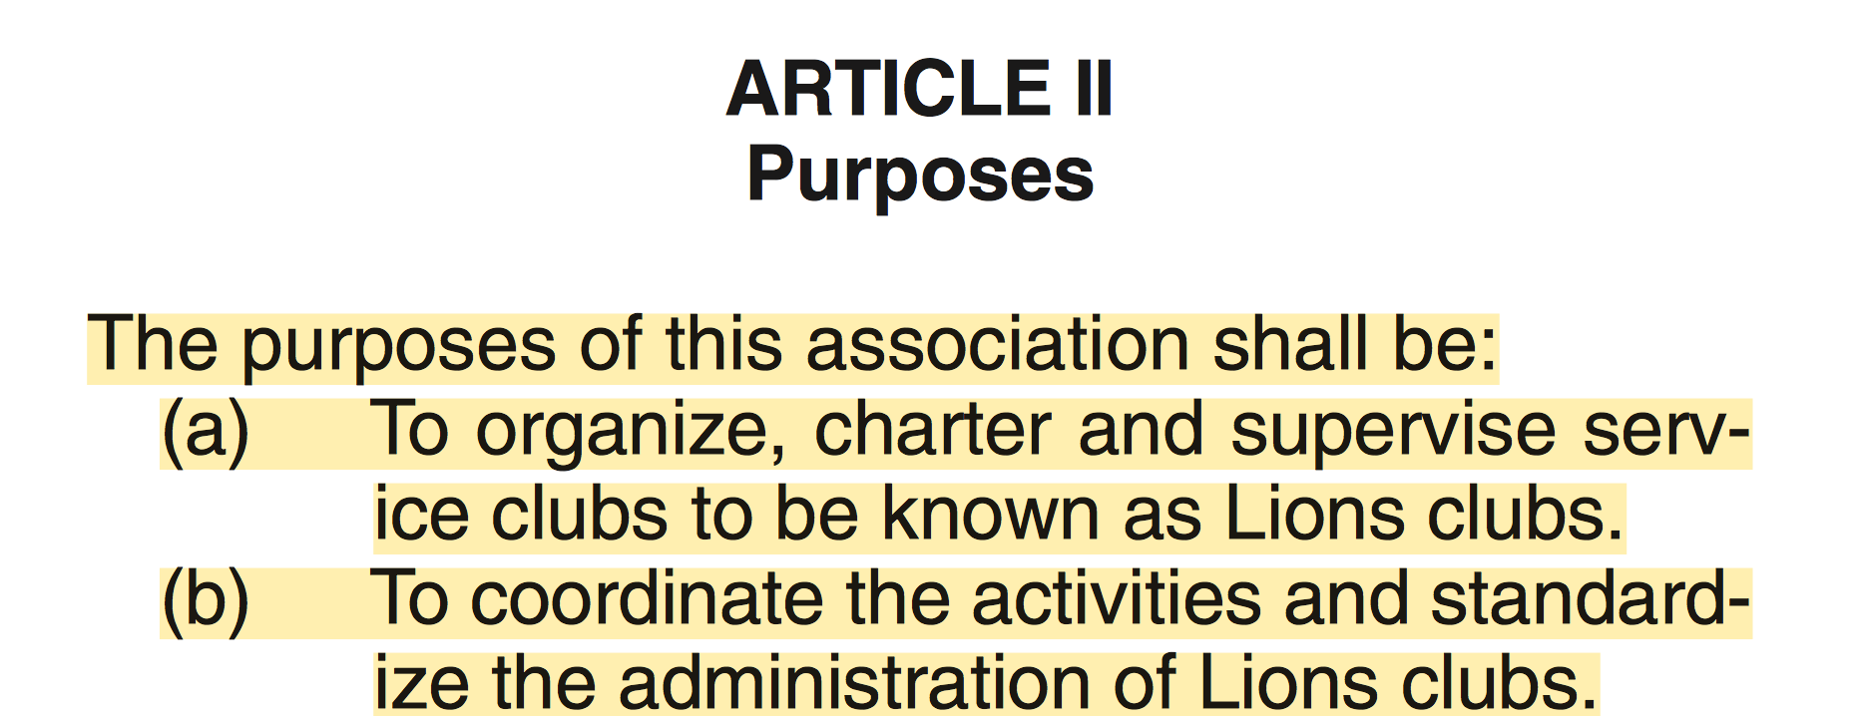

Slide 13
Constitutionally Required Committees
Editing Committee (Just CC and Council Sec)
Credentials Committee (Council Appoints Chair, Cab. Secs are members)
State Awards (Council selects Chair, 3 year appointments)
Constitution & Bylaws (Council selections Chair, 3 year appointments)
International Convention (Council member chairs, 3 year appointments)
State Convention (Council member chairs, 3 year appointments)
International Candidates (Council selects Chair, 3 year appointments)

Slide 14
Constitutional Committees Continued
Long Range Planning (Council selects Chair, 3 year term, PDG)
State Pin Committee (Council selects Chair, 3 year term)
State Web Master (Council selects Chair, 3 year term)
All State Band (Council selects Chair, 3 year term)
Rules (Council selects Chair, 3 year term)
Resolutions (Council selects Chair, 3 year term)
Uniform (Chaired by Lion Tamer, Annual Appointments)

Slide 15
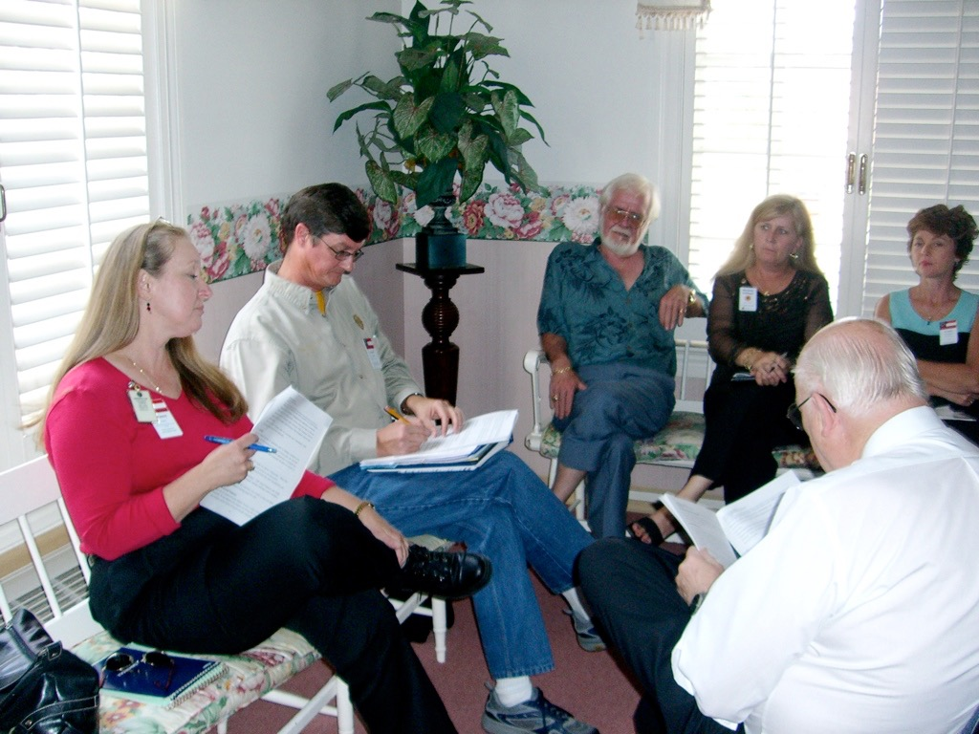
International Recommended Committees
GLT (3 year term)
GMT (3 year term)
LCIF
Opportunities for Youth
Lions Quest

Slide 16
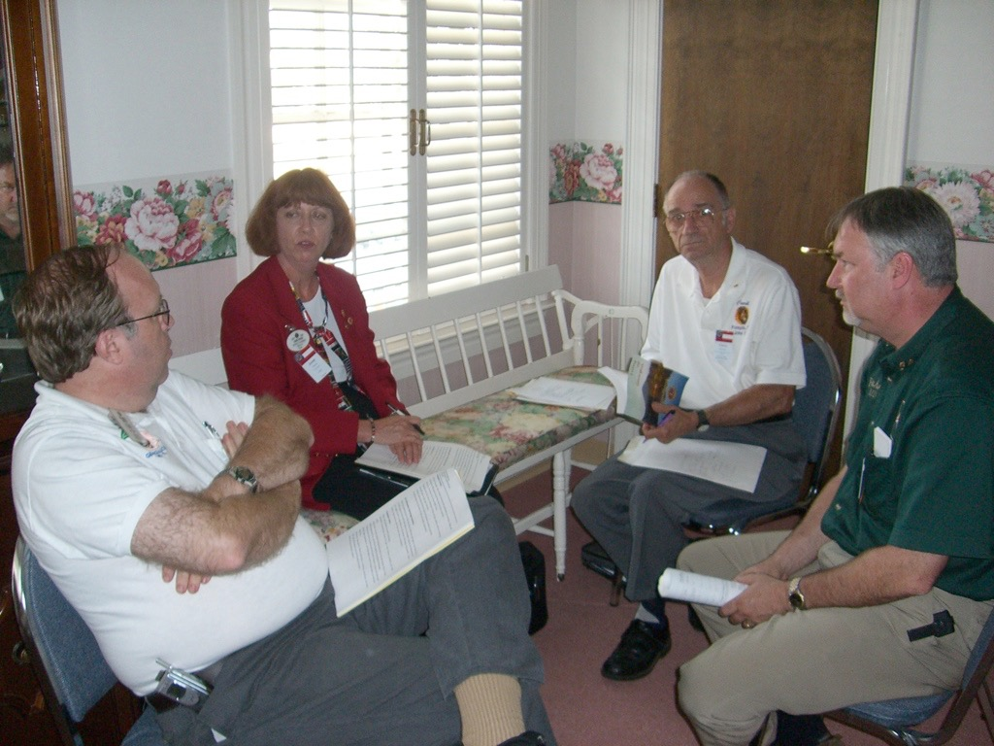
LCI Committees Cont.:
Youth Exchange
Leo
International Relations
Protocol
Sight Conservation
Diabetes Awareness
Information Technology
Public Relations

Slide 17
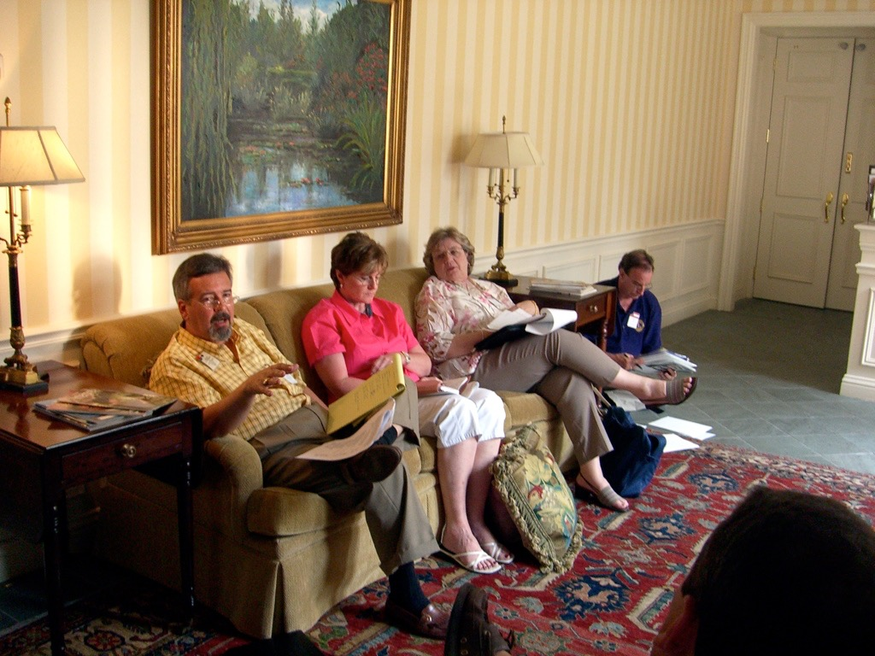
Others State Comm:
State Nominations & Elections
Song leader
Blind/Sullivan/Hearing Awards
Golden Chain
Liberty Day
Newspaper Editor
Leader Dog Rep

Slide 18
New District Structure
DGE Team
Quality Club Team
Club Coaches
New Club Team
District Service Teams

Slide 19
District Service Teams
Admin Team
Health Team
Youth Team
Club Support Team

Slide 20
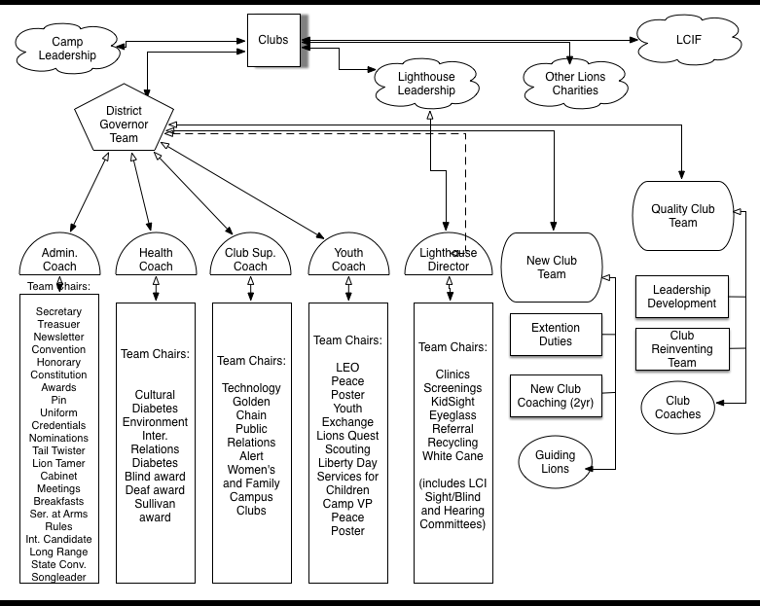

Slide 21
Build a Good Club and Good Members Will Join

